Slide 1
KeepItGreen – Plant Leaf Disease Detection App
Submitted in the partial fulfillment for the award of the degree of
BACHELOR OF ENGINEERING
IN
COMPUTER SCIENCE ENGINEERING
IN ARTIFICIAL INTELLIGENCE AND
MACHINE LEARNING
Submitted by:
Divyansh Dodan
Nancy Tyagi
Sweety
Shivam
Sahil Thakur
Under the Supervision of:
Ms.Shivani
Department of AIT-CSE
DISCOVER . LEARN . EMPOWER

Slide 2
MAIN PURPOSE OF PROJECT:
This project is about collecting images of various infected, good and seemingly infected plant leafs. Then apply image processing on the images and predict the infected plant leaf’s using Deep Learning + Image Processing.
The main purpose is detect the diseased part of the leaf. Using python, Convolutional neural network are implemented in order to classify the diseased part. Aim is to detect the diseased part by finding the optimum way with minimum cost.

Slide 3
Libraries and Tools Required:
Tensorflow
Keras
Jupyter notebook
Scikit learn
OpenCV

Slide 4
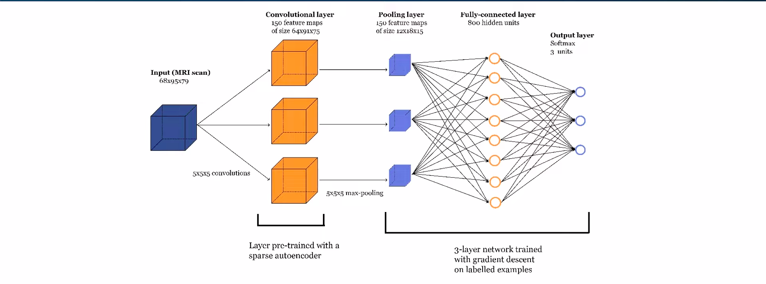
WORKFLOW

Slide 5
Dataset used in project:
We used dataset from kaggle. i.e. New Plant Diseases Dataset (Image dataset containing different healthy and unhealthy crop leaves).
This dataset is recreated using offline augmentation from the original dataset.
This dataset consists of about 87K RGB images of healthy and diseased crop leaves which is categorized into 38 different classes.
The total dataset is divided into 80/20 ratio of training and validation set preserving the directory structure. A new directory containing 33 test images is created later for prediction purpose.

Slide 6
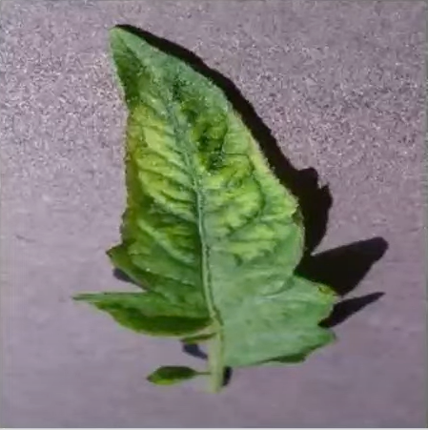
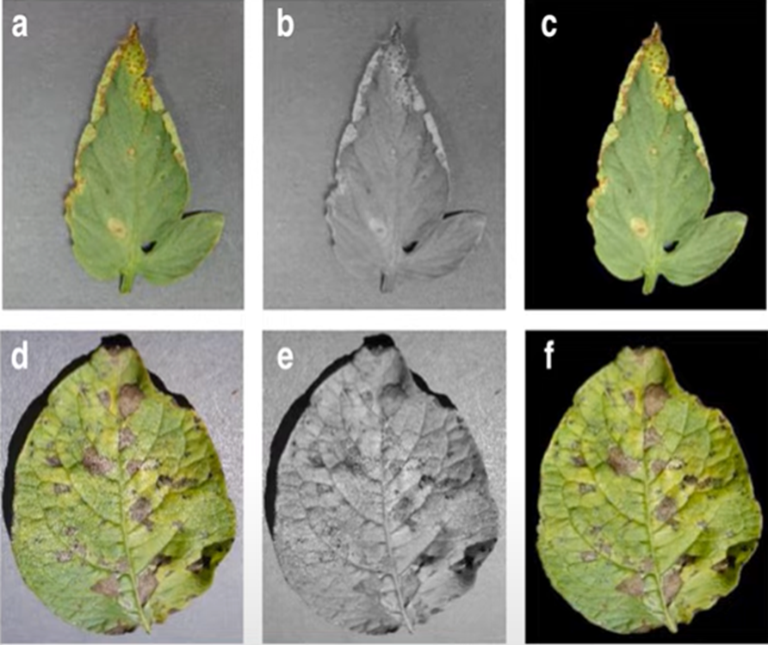
Images From Dataset:

Slide 7
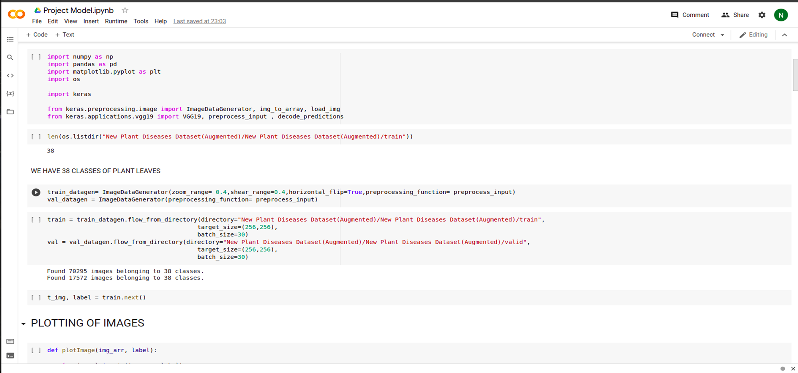
PREPROCESSING

Slide 8
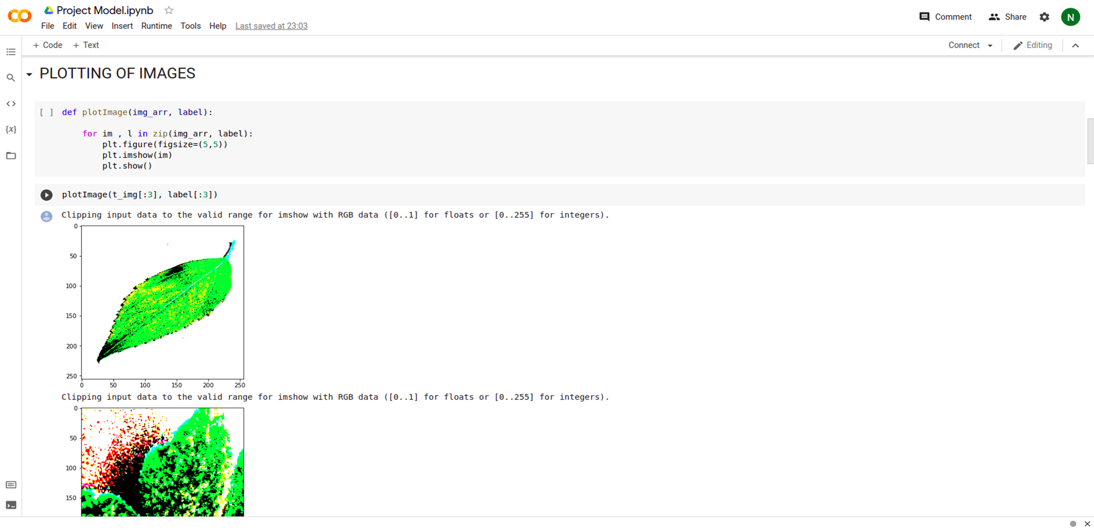

Slide 9
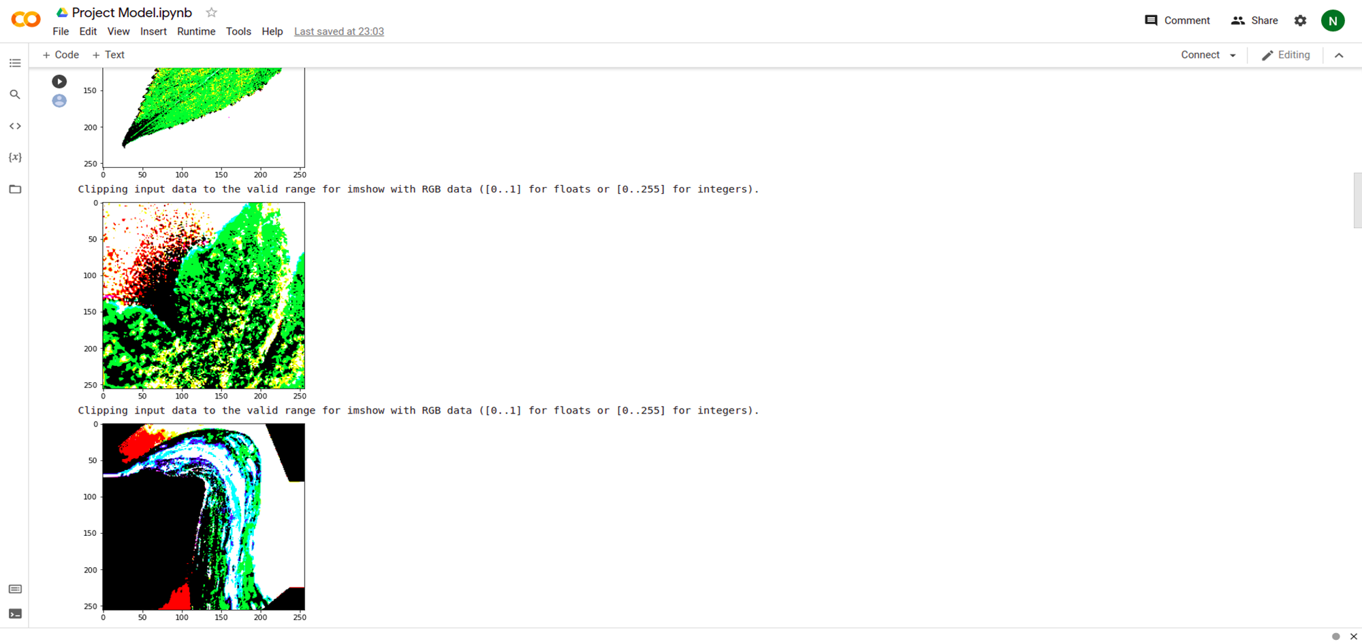

Slide 10
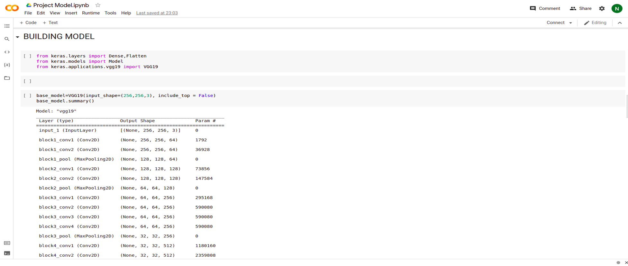
BUILDING MODEL

Slide 11
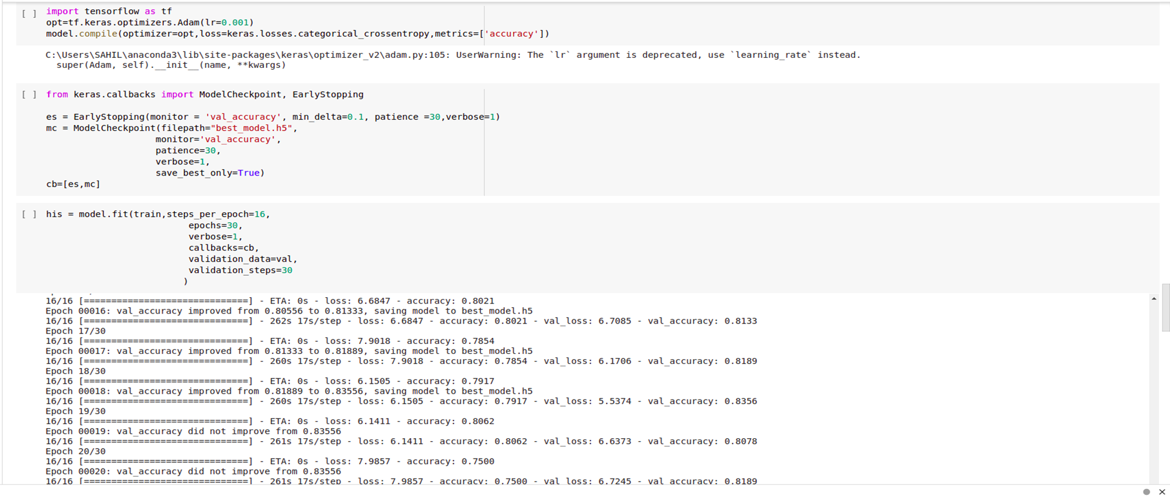
Early stopping and Model Check point

Slide 12
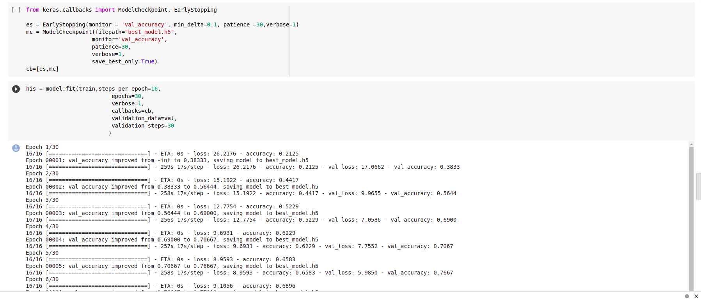
Model Training

Slide 13
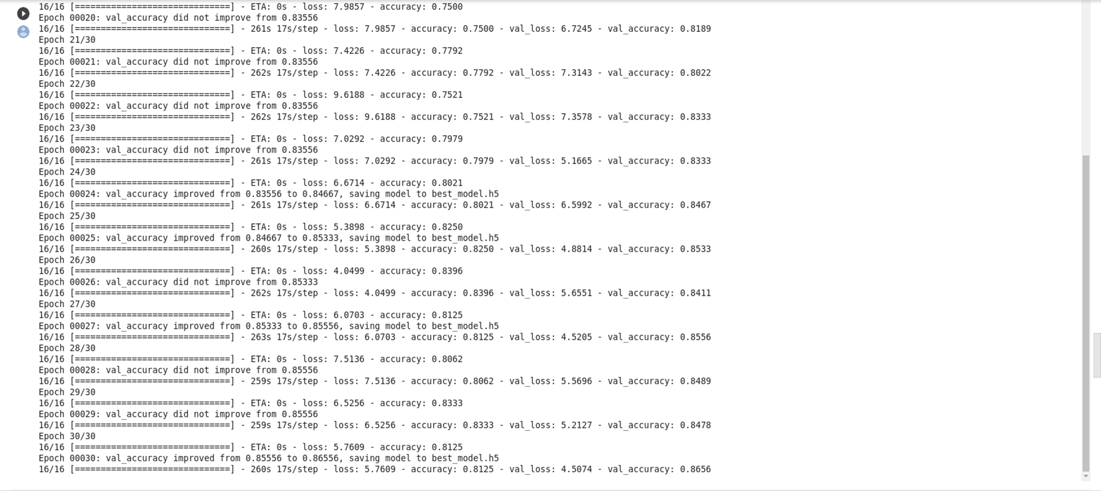

Slide 14
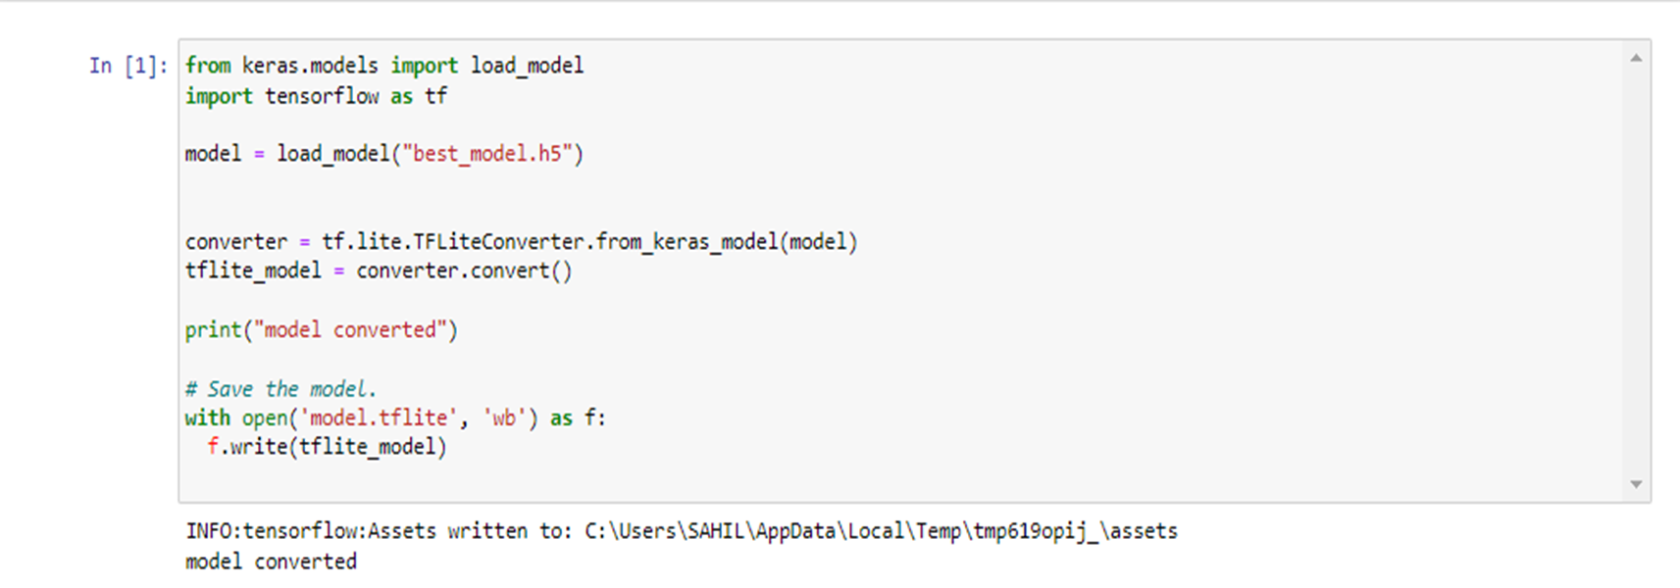
CONVERT OUR MODEL TO TFLITE

Slide 15
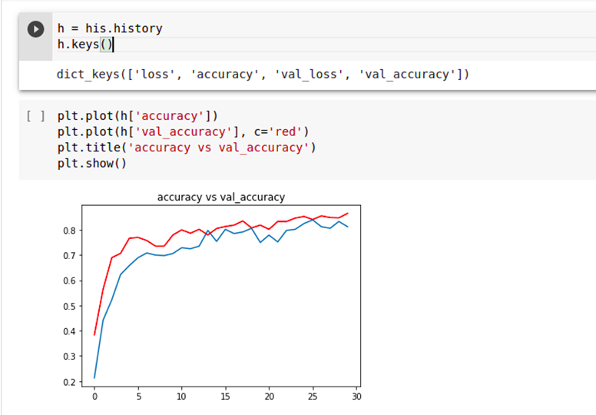
ACCURACY VS VALIDATION ACCURACY
The gap between accuracy and validation accuracy is not high.

Slide 16
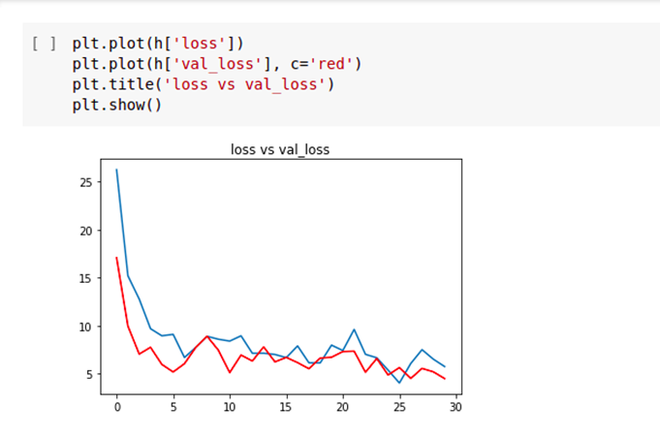
LOSS VS VALIDATION LOSS
Also the gap between the loss and validation loss is narrow too.

Slide 17
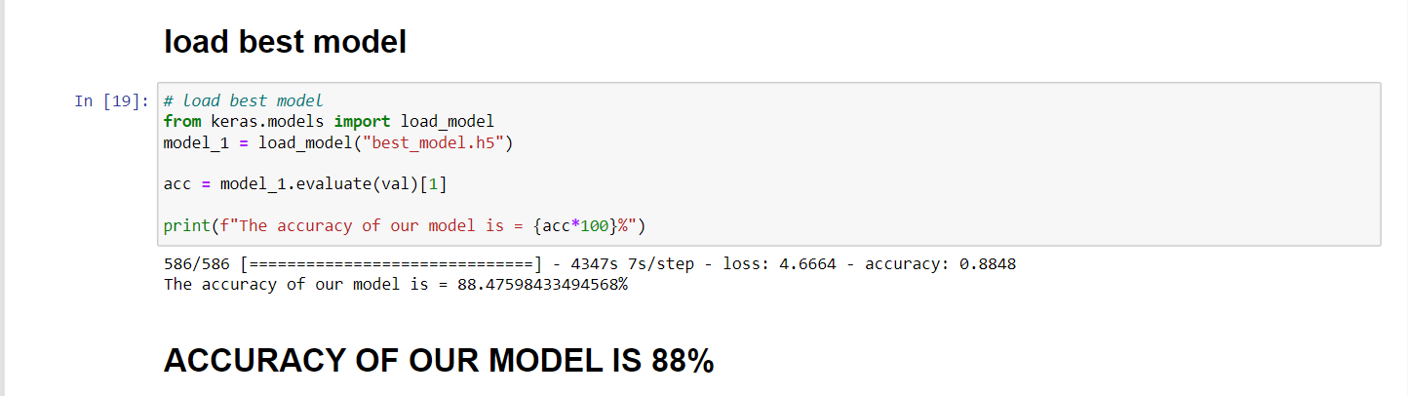
RESULT

Slide 18
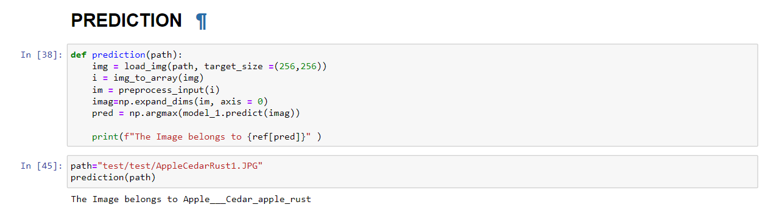
OUTPUT

Slide 19
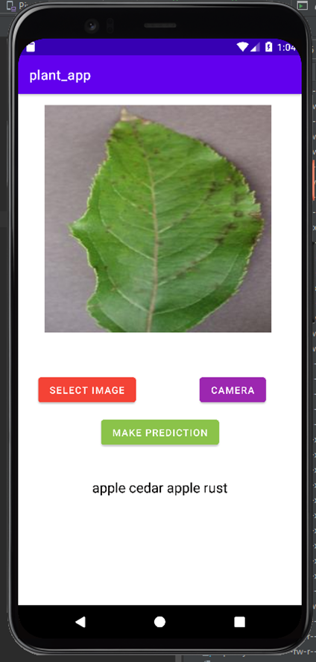
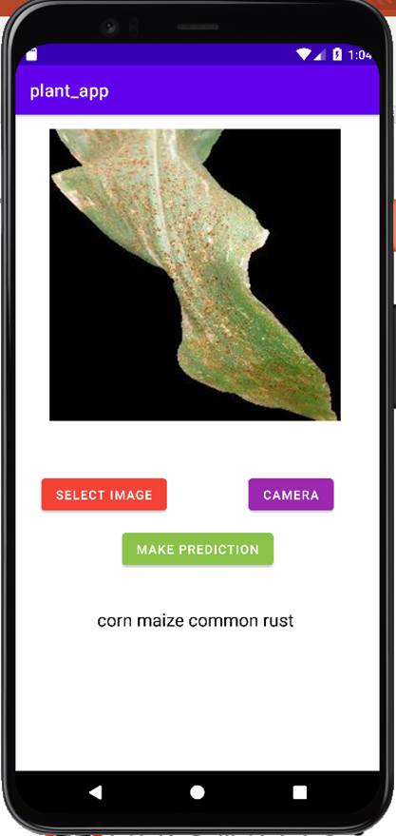
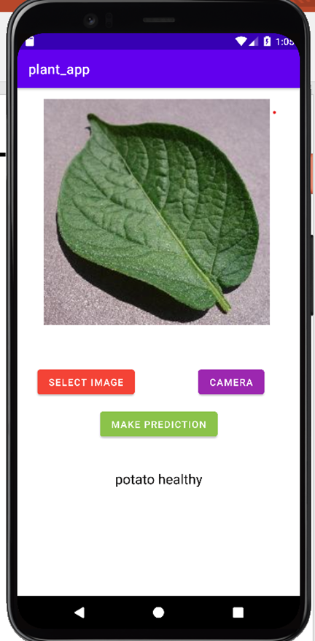
APPLICATION DEMONSTRATION

Slide 20

THANK YOU

